Slide 1

NEXO – Online Banking System
Ravi Sardhara – Kishan Ramani

Slide 2
The Problem
Time-Consuming Manual Banking
Limited Global Payment Options
Lack of Student-Friendly Solutions
Traditional banking involves long queues and limited hours, a major hurdle for busy students.
Existing systems often lack robust multi-currency support, complicating international transactions and travel.
Many banking services are not tailored to the unique financial needs and digital-native habits of college students.

Slide 3

Our Solution – NEXO
Secure, Student-Friendly Banking: NEXO provides a robust, intuitive platform designed with student financial wellness in mind.
Multi-Currency Support: Seamlessly manage funds across various currencies, making international transactions effortless.
Easy Transactions, 24/7 Access: Perform banking operations anytime, anywhere, with instant transaction capabilities.

Slide 4




Key Features
Global Account Access
Real-Time Currency Exchange
Manage your finances from anywhere in the world, securely and instantly.
Convert currencies at competitive rates, with live updates to ensure optimal transactions.
Smart Payments
Easy Withdrawals
Automate bills, split expenses, and send money with intelligent, fast payment options.
Access your funds conveniently through integrated ATM networks and secure digital processes.

Slide 5

System Architecture
Frontend
Backend
Database
HTML: Structure and content
PHP: Robust and scalable server-side logic
MySQL: Relational database for transactions
CSS: Styling and layout
JavaScript: Interactivity and dynamic content
Data Encryption: Secure storage of financial data

Slide 6
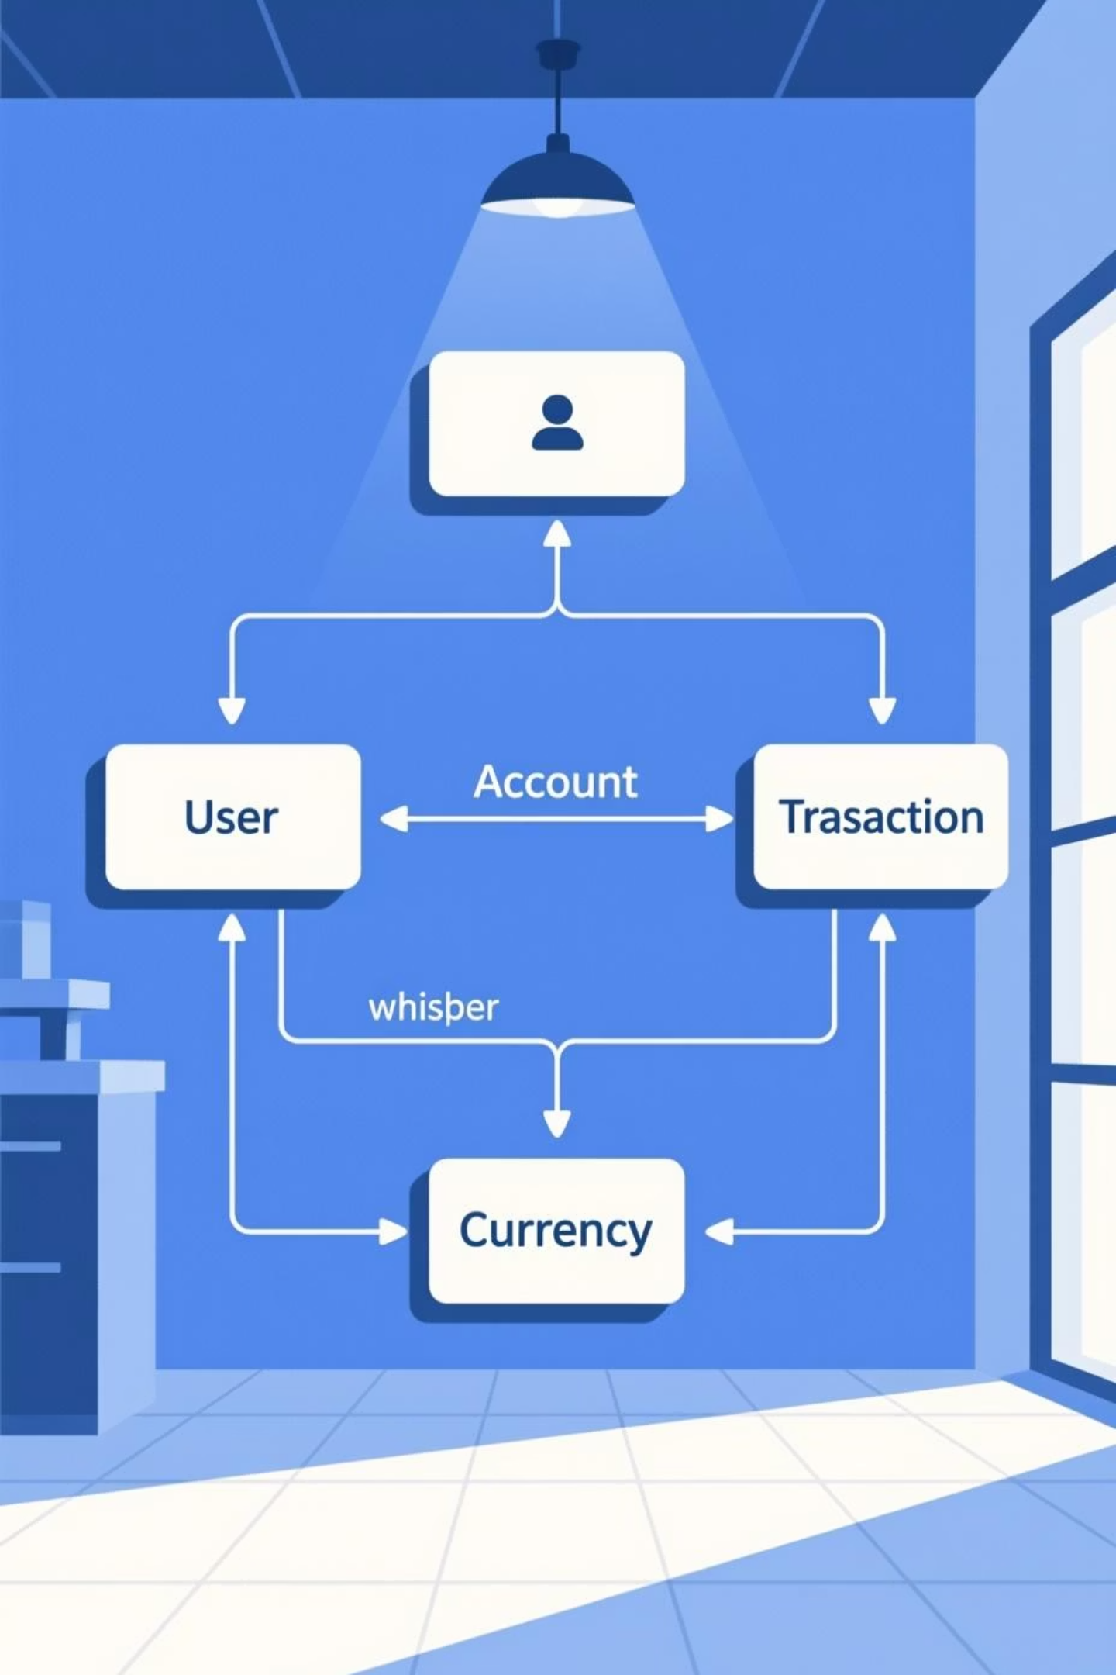
Database Design (ERD)
Our Entity-Relationship Diagram (ERD) meticulously maps out the relationships between key entities such as Users, Accounts, Transactions, and Currencies. This design ensures data integrity, scalability, and efficient query performance for all banking operations.
The ERD provides a clear blueprint for our database, enabling a robust and reliable system for NEXO.

Slide 7
System Modules
Registration & Login
1
Secure user onboarding with multi-factor authentication.
2
Account Management
View balances, transaction history, and manage personal details.
Transactions
3
Facilitates deposits, withdrawals, transfers, and bill payments.
4
Admin Panel
Tools for system administrators to manage users, resolve issues, and monitor system health.

Slide 8
Why NEXO Works
Easy Adoption for
Students
Secure Financial
Transactions
Scalable for Future
Features
Its intuitive design and mobile-first approach resonate with the digital-savvy student demographic.
Implementing industry-standard encryption and security protocols ensures the safety of all user data and funds.
The modular architecture allows for easy integration of new functionalities and expansion to a wider user base.
NEXO is not just a banking system; it's a foundation for a modern, accessible, and secure financial future for students.

Slide 9
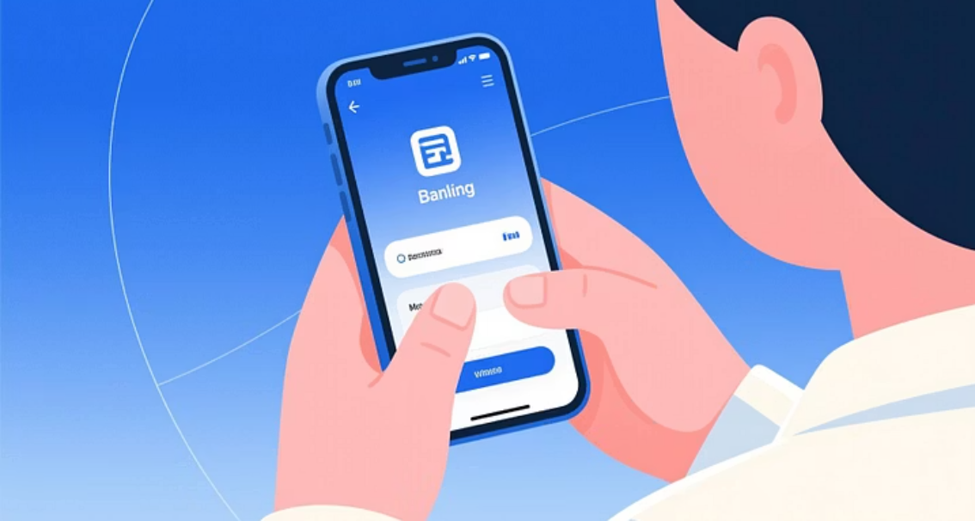


Future Enhancements
NEXO's journey doesn't end here. We envision a roadmap of continuous innovation, including:
Mobile Responsive Design – Ensure seamless access on smartphones and tablets for modern banking needs
AI-based Fraud Detection: Advanced machine learning algorithms to proactively identify and prevent suspicious activities.
Multi-language Support: Expanding NEXO's reach to a global audience by offering support in multiple languages.

Slide 10
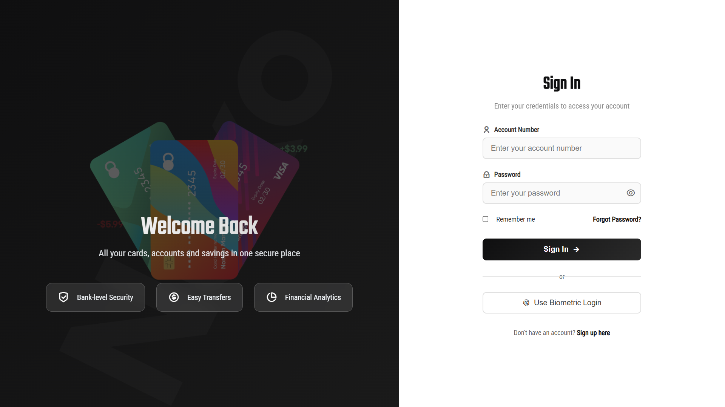
Nexo - Ui
Login Page :

Slide 11
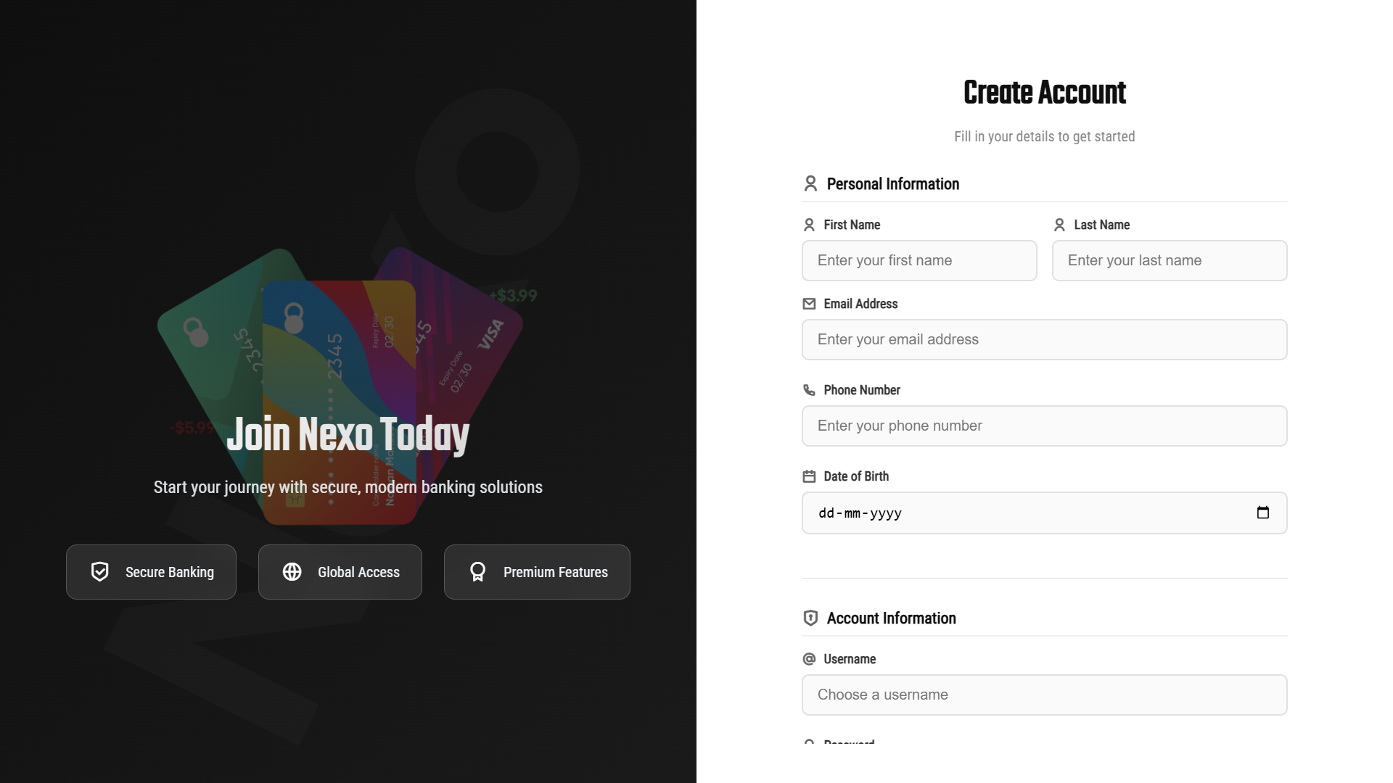
Nexo - Ui
Register Page :

Slide 12
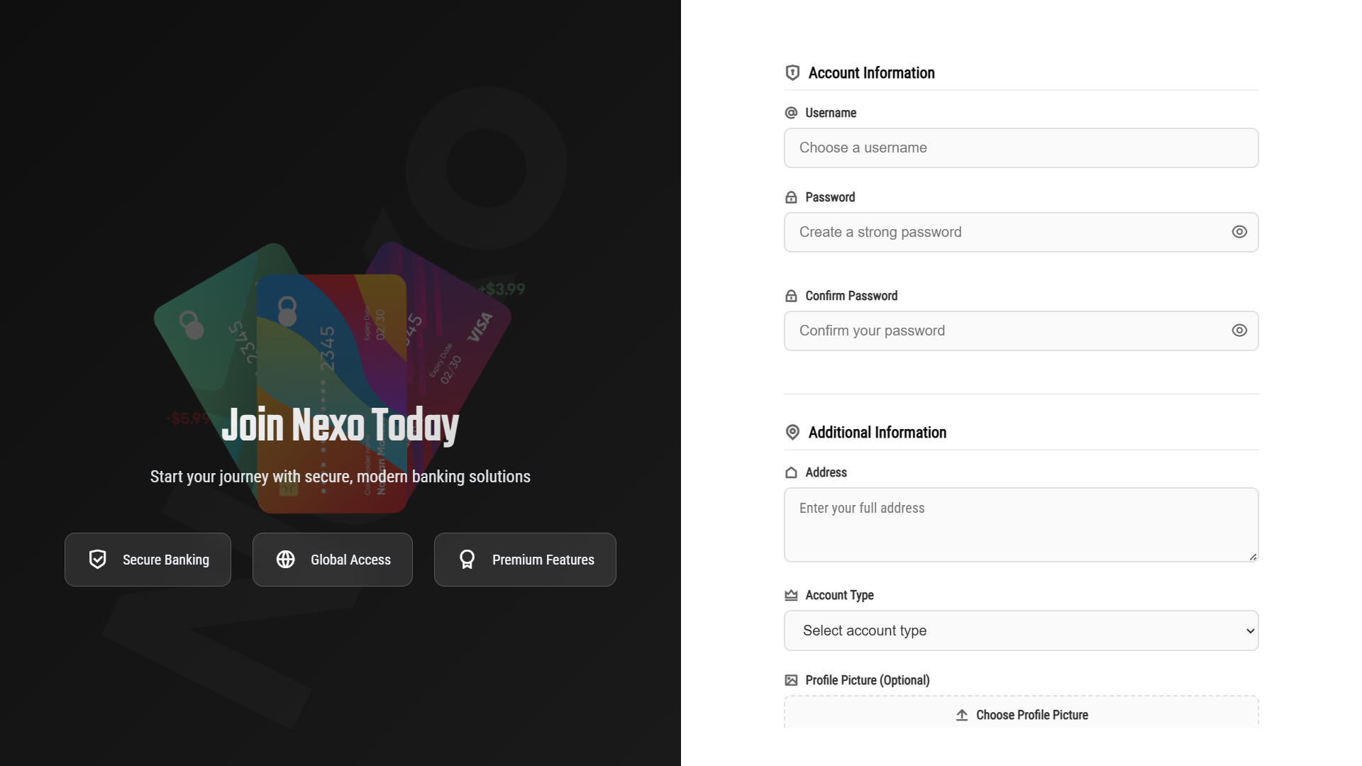
Nexo - Ui
Register Page :

Slide 13
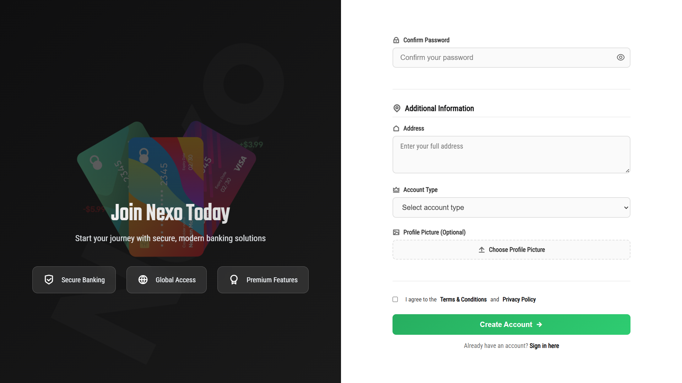
Nexo - Ui
Register Page :

Slide 14
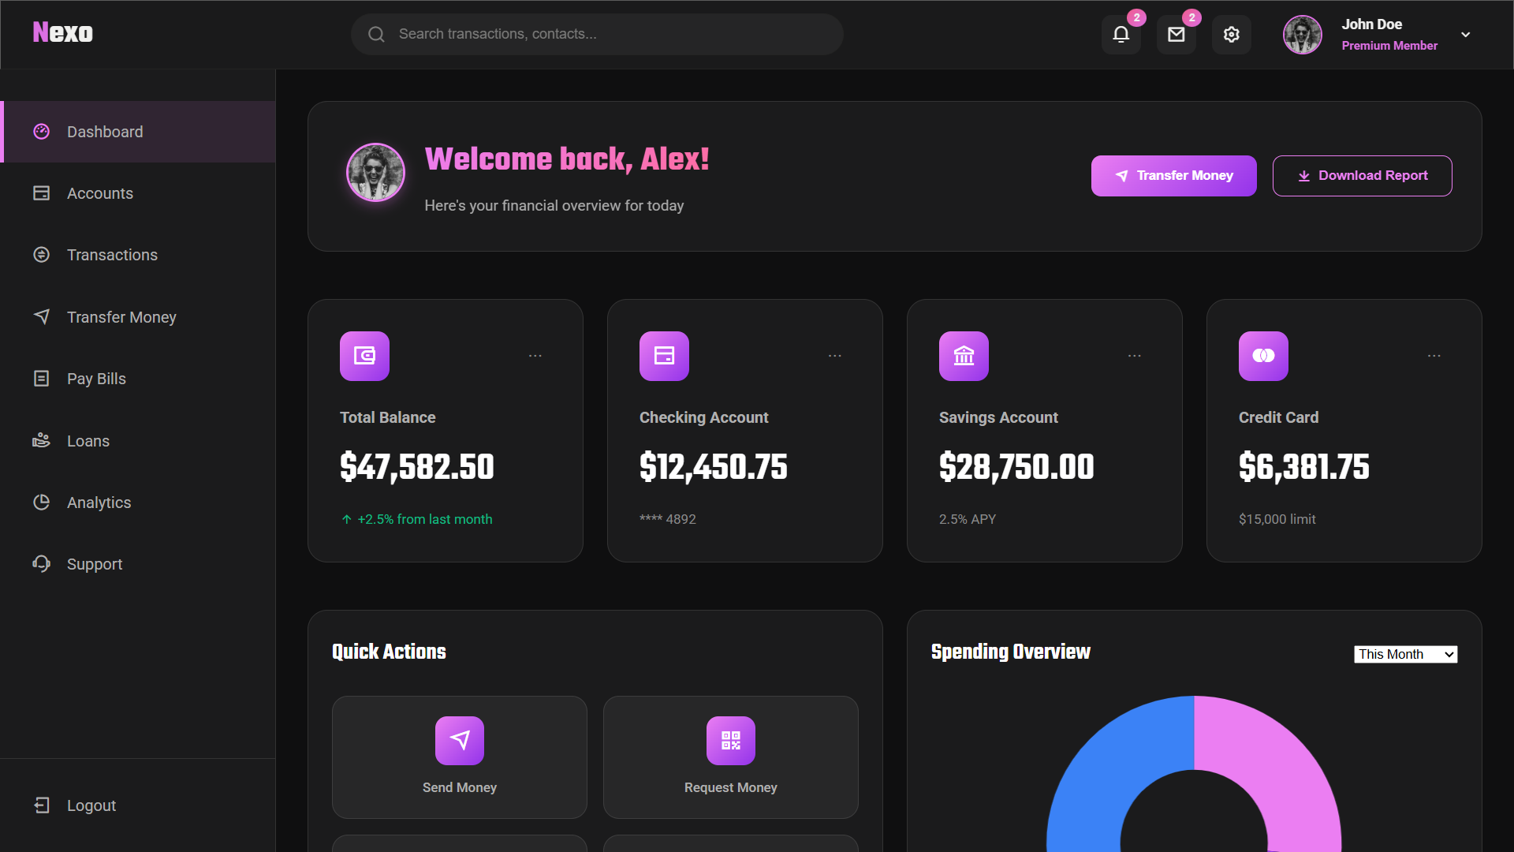
Nexo - Ui
Dashboard :

Slide 15
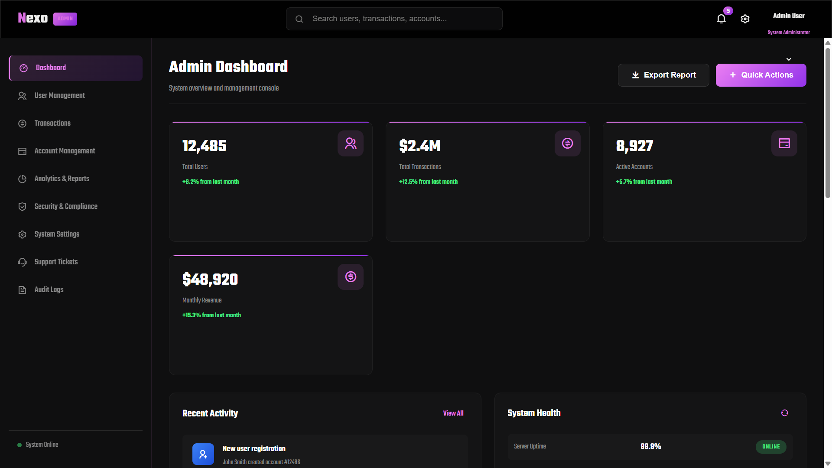
Nexo - Ui
Admin Panel :

Slide 16

Thank You
Have a nice day

